Slide 1
Design Patterns
Façade, Adapter Patterns
It 426

Slide 2
The Façade Pattern
Simplifying our interfaces!

Slide 3

Definition
Gang of four
“Provide a unified interface to a set of interfaces in a subsystem. Façade defines a high-level interface that makes the subsystem easier to use.”

Slide 4
Participants
Subsystem
An existing code module.
Façade
A new code module that encapsulates and simplifies existing modules.

Slide 5
Goals
Unifying multiple interfaces
Providing a simpler interface
Decouples a subsystem from other clients/systems
Order Services
createOrder(items, customer)
generateOrderId()
isOrderFulfilled()
updateAddress(address)
updateShipping (method)
sendConfirmationEmail()
Card Services
verifyFunds(orderId)
chargeAccount(orderId)
saveUserCard(card)
addOrderPayment(card)
giveRefund(orderId)
Shipping Services
isShipped(orderId)
addComment(orderId, comment)
createNewShipment(orderId)
arrivalDate(orderId)

Slide 6
Benefits
Clients now interact with OrderFulfillment
This decouples our subsystems
Clients deal with less objects
You can still use subsystems if you need to
OrderFulfillment
createNewOrder(customer, items)
checkOut(customer, items)
ship(orderId)
Order Services
Card Services
Shipping Services

Slide 7
Benefits
We can more easily make changes to our subsystems by just updating the internals of our facade
OrderFulfillment
createNewOrder(customer, items)
checkOut(customer, items)
ship(orderId)
Order Services
New Card Services
Shipping Services

Slide 8
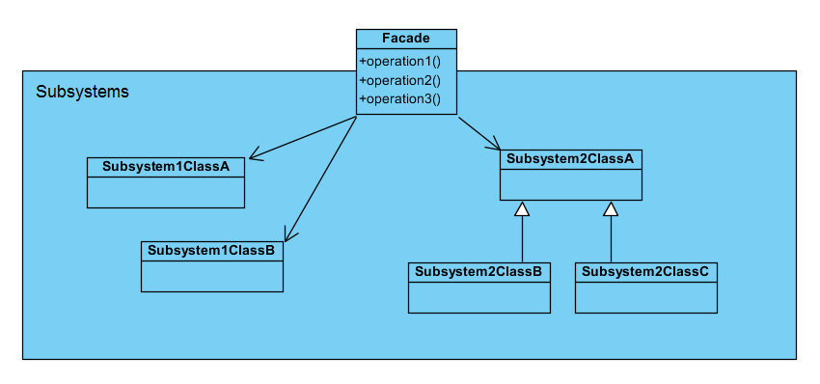
The Façade Pattern

Slide 9
The Adapter pattern
Making things fit

Slide 10

Definition
Gang of four
“Convert the interface of a class into another interface clients expect. Adapter lets classes work together that couldn’t otherwise because of incompatible interfaces.”

Slide 11
Participants
Adaptee
A class that you would like to work with within the target system.
Adapter
A class that encapsulates the Adaptee and makes provides a compatible interface for the target system.
Target (System)
An existing system within which we would like to use the Adaptee class.

Slide 12
Mismatched interfaces
Sometimes the interface of a source class is not compatible with a subsystem
public interface
Target System
Adaptee
expected interface

Slide 13
Mismatched interfaces
We need public methods in our source class that the subsystem understands
But we do not want to alter our source class
The open-closed principle!
Adaptee
Target System
Incompatible

Slide 14
Mismatched interfaces
Create a new Adapter class that has the methods we need
The Adapter will store our source class internally
Adapter
Target System
Adaptee

Slide 15
Mismatched interfaces
The subsystem makes requests of the Adapter
The Adapter passes on requests to the source object
Adapter
Target System
Adaptee

Slide 16
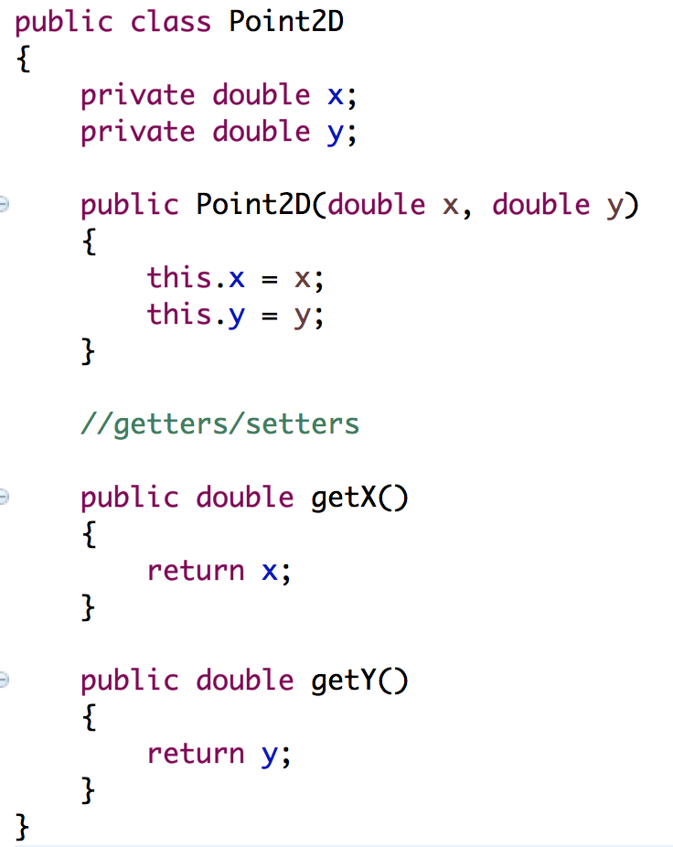
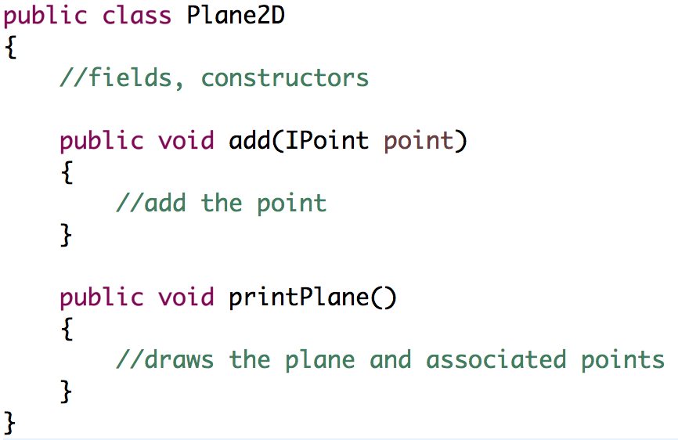
The point 2D problem
The Plane2D class is built to work with Point2D objects

Slide 17
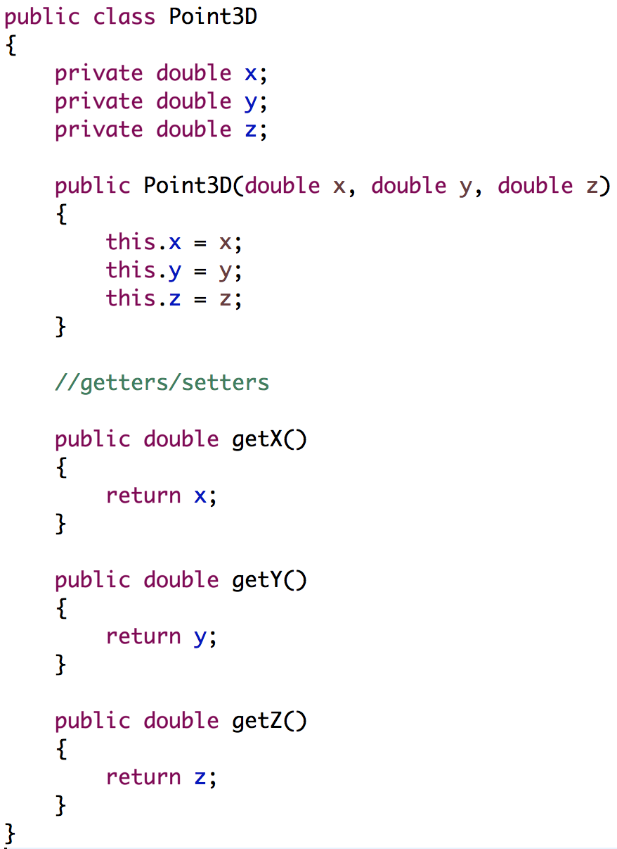
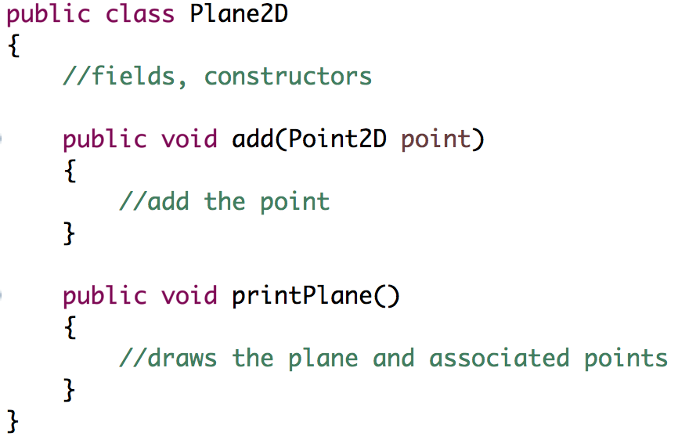
The point 2D problem
Can we make the Point3D class compatible with the Plane2D class?

Slide 18
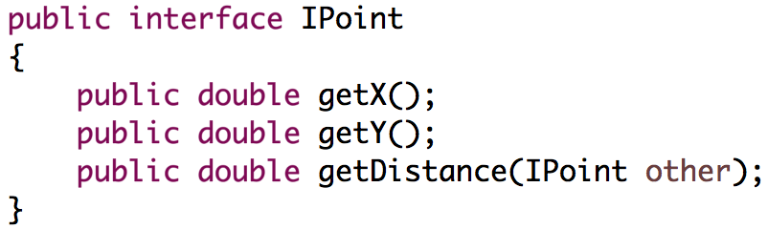
The point 2D problem
First, program against an interface

Slide 19
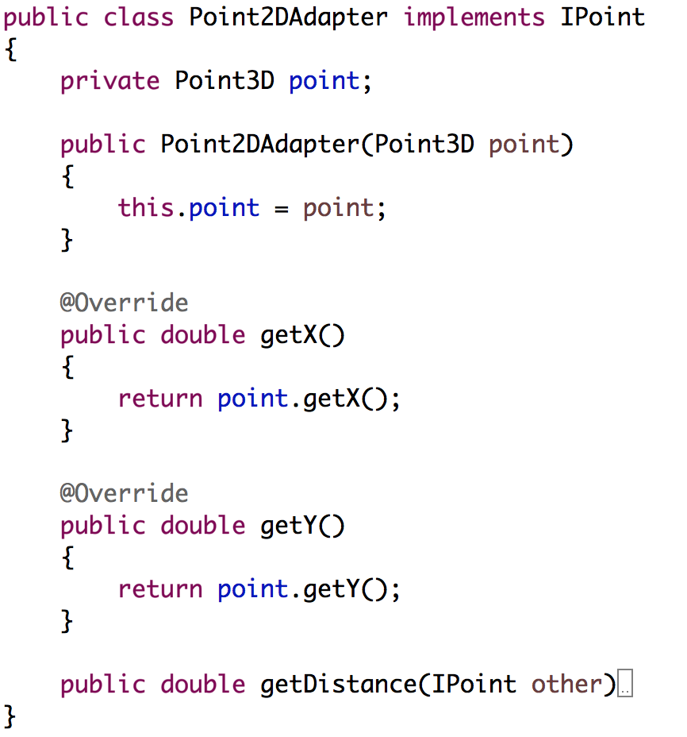
The Adapter pattern
Create an adapter class to make a class compatible

Slide 20
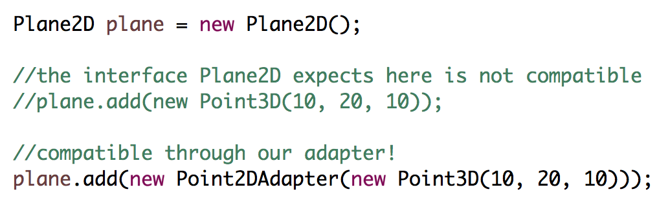
The Adapter pattern
Using our new Adapter!

Slide 21
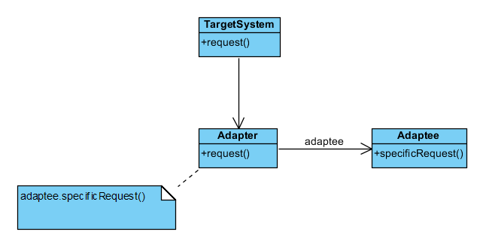
The adapter pattern

Slide 22
Sources
Gamma, Erich, et al. Design Patterns: Elements of Reusable Object-Oriented Software. Indianapolis, IN: Addison-Wesley, 1994

Slide 23
Design Patterns
Façade, Adapter patterns
It 426

